Slide 1

Data Science Final
Robert Guenther
Summer Hits 1960-2017

Slide 2

Prerequisites that I used
I used ggplot
I also used tidyverse

Slide 3
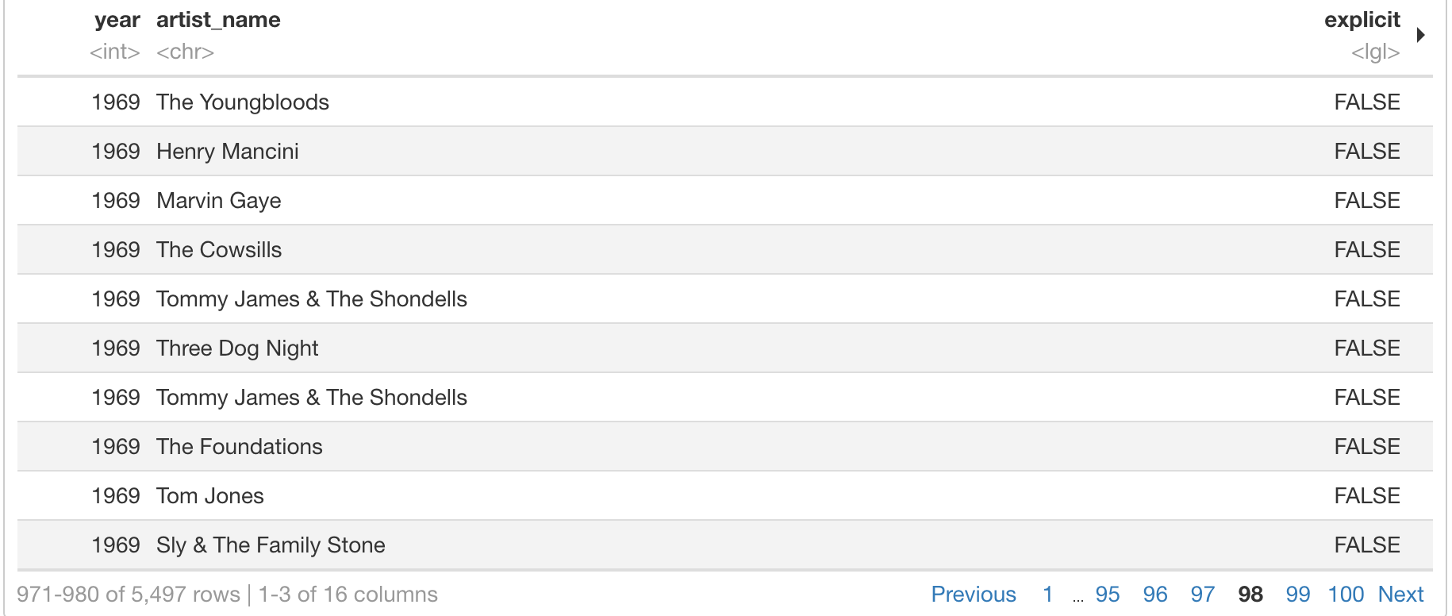

BB top 100
I chose the bbtop100 data from Professor Sanchez’s github
This data gave me the billboards top 100 from 1960-2017 but on the chart it would only allow me to view up until 1970.
The dataset gave me the artists name, the year it was selected, and the track.

Slide 4
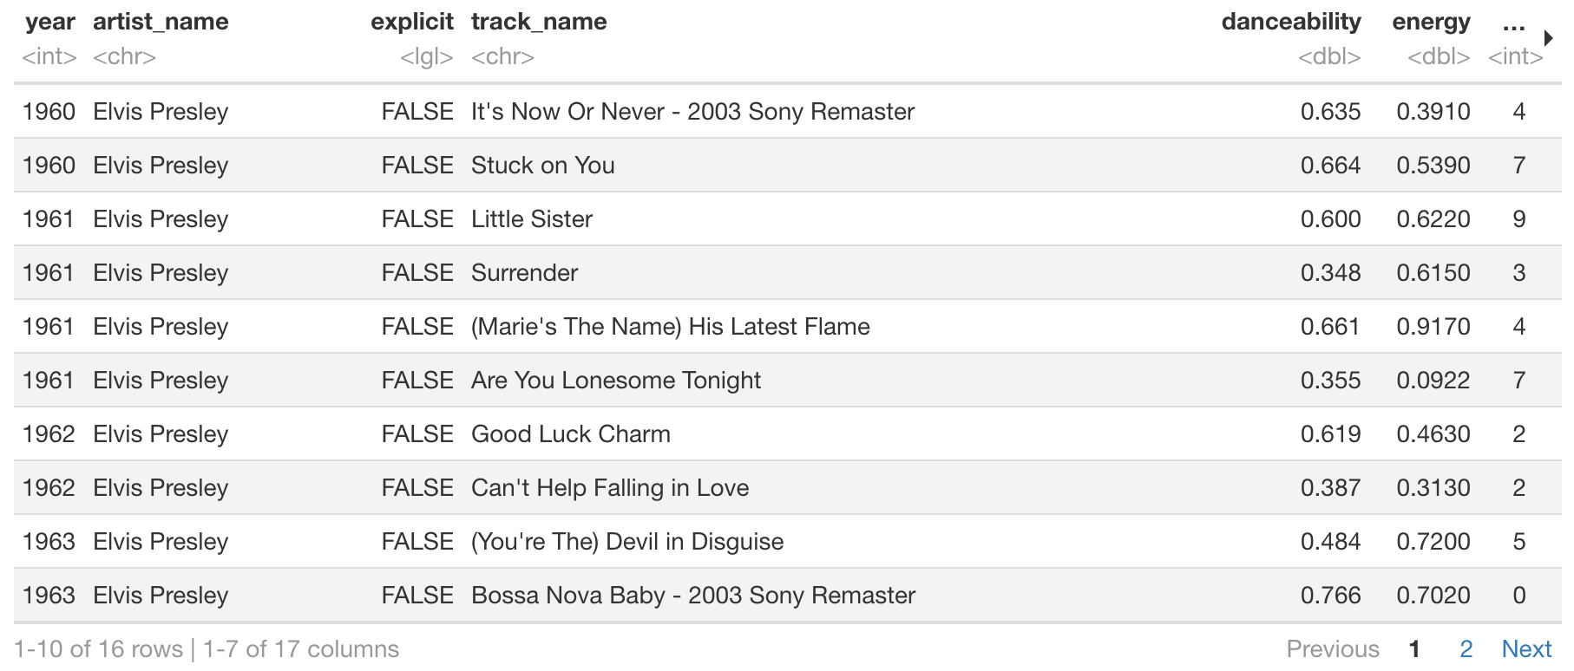
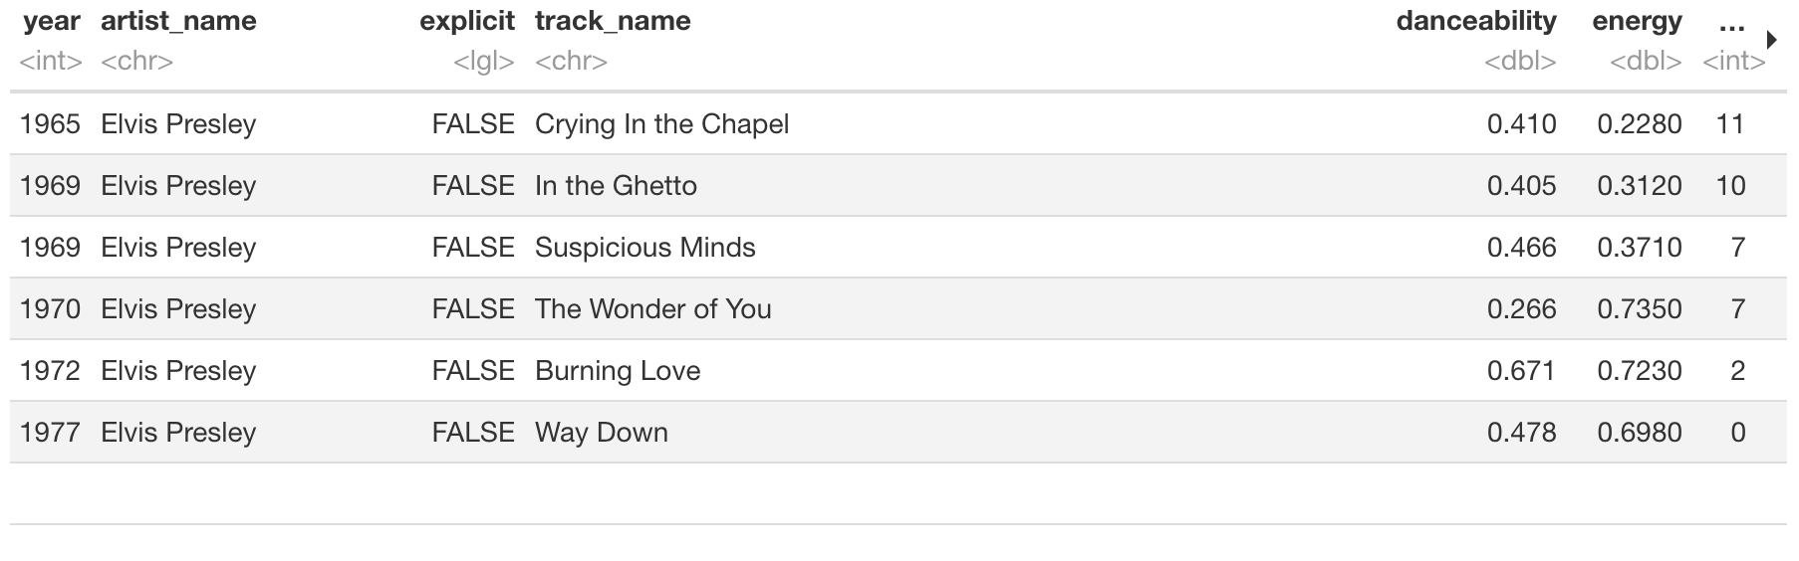

With this data I was able to mutate one of the columns to see if the Artists name name was Elvis
Between 1960-1977 Elvis had 16 songs on the top 100s list.

Slide 5
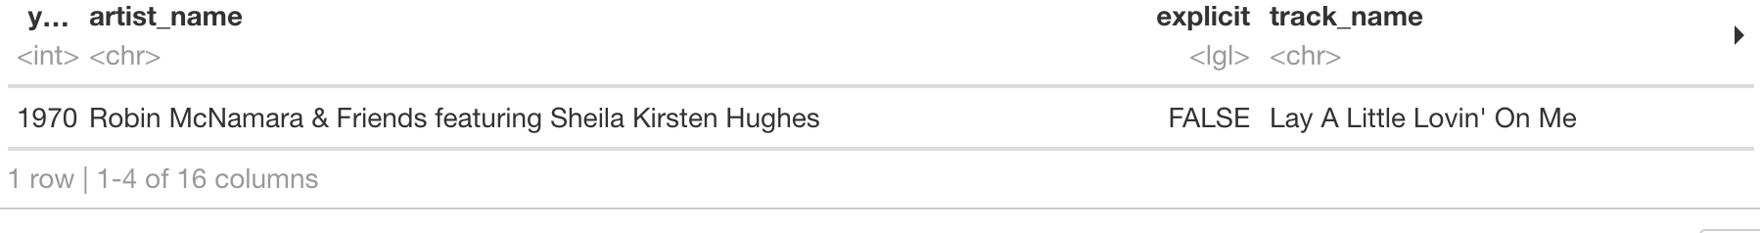

My second question I was trying to answer with the data was how many songs had features.
Out of the 5,497 songs only one song had a feature

Slide 6
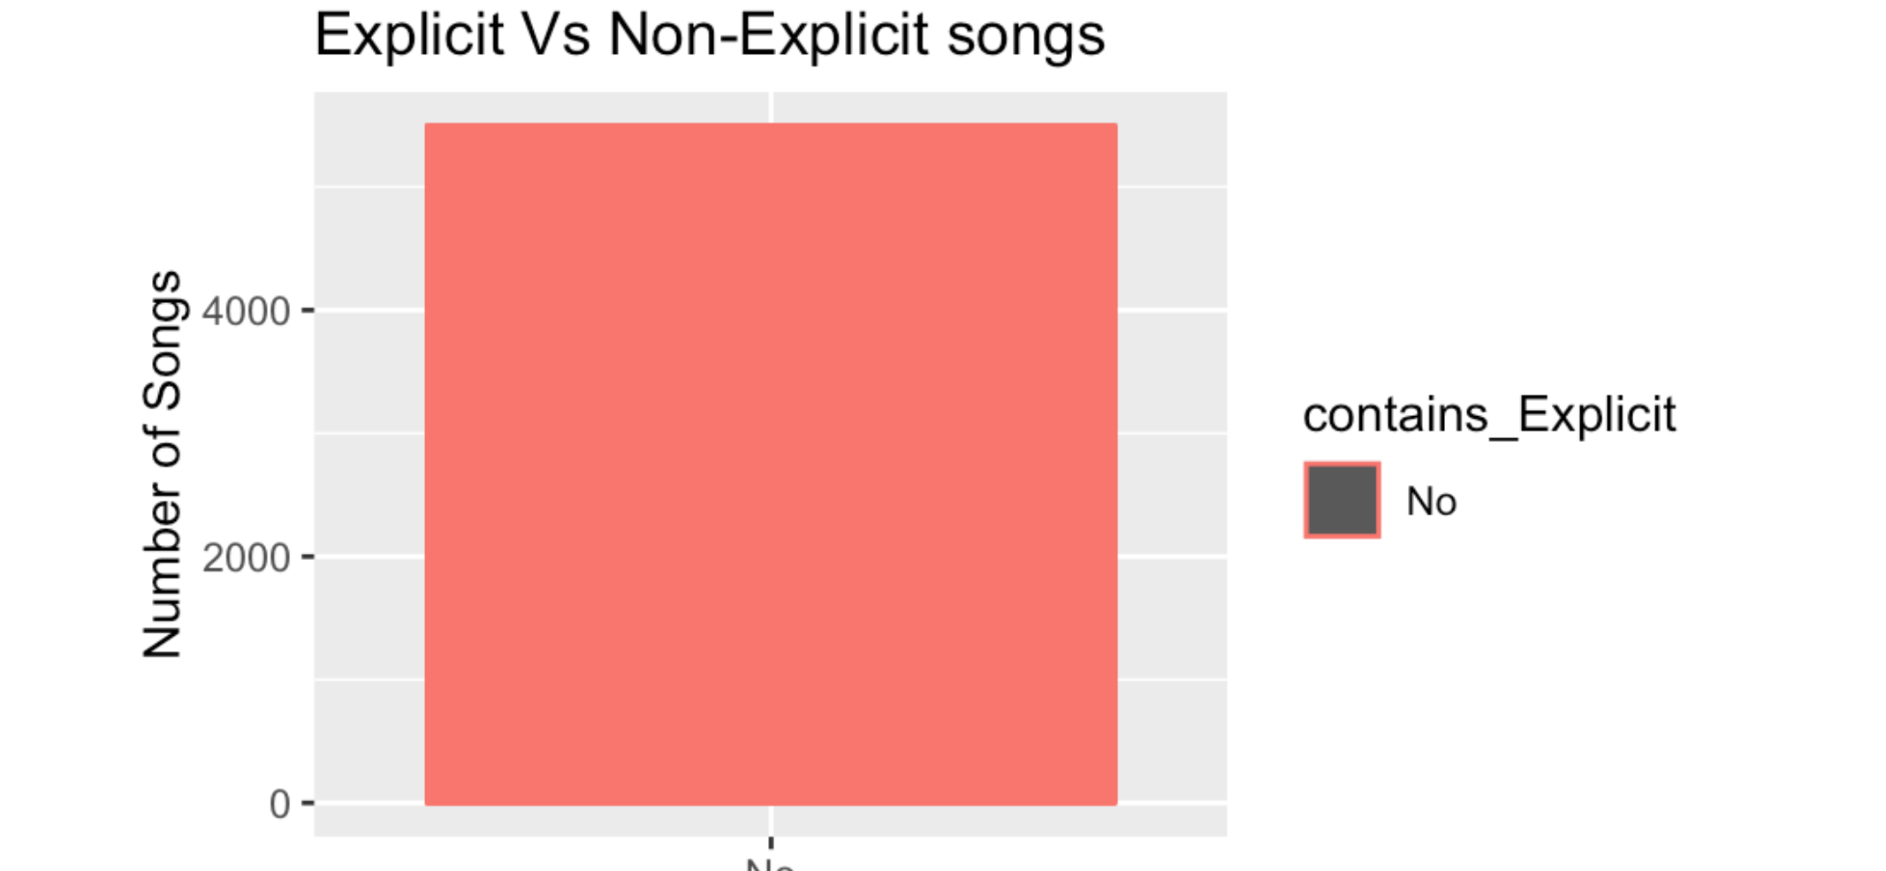

The last question I was trying to answer was out of all these songs how many were explicit?
Surprisingly there there was no songs that were explicit.

